Slide 1
Checking understanding of arithmetic sequences
Non-linear relationships

Slide 2
how to use Oak lessons

Slide 3
I can appreciate that any term in an arithmetic sequence can be expressed in terms of its position in the sequence and generate any term.

Slide 4
An arithmetic (or linear) sequence is a sequence where the difference between successive terms is a constant.
E.g. 10, 12, 14, 16, 18,...
E.g. 10, 12, 15, 19, 24,...
This is an arithmetic sequence with a common difference of +2
+2
+2
+2
+2
This is not an arithmetic sequence because there is not a common difference between successive terms.
+2
+3
+4
+5
The n^{th} term of a sequence is the position of a term in a sequence where n stands for the term number. For example, if n = 10 this means the 10th term in the sequence.

Slide 5

Checking understanding of arithmetic sequences
Identifying arithmetic sequences
Generating arithmetic sequences
Representations of arithmetic sequences

Slide 6



Identifying arithmetic sequences
Sofia is looking at some number sequences.
6, 11, 16, 21, 26, …
+5
+5
+5
+5
Whilst these are all different sequences I can see something they all have in common.
19, 23, 27, 31, 35, …
+4
+4
+4
+4
51, 58, 65, 72, 79, …
All three sequences increase in equal steps each time
+7
+7
+7
+7

Slide 7
Identifying arithmetic sequences
Sofia is looking at some number sequences.
6, 11, 16, 21, 26, …
+5
+5
+5
+5
Sequences with a common difference are called arithmetic sequences. You may also hear them called linear sequences.
19, 23, 27, 31, 35, …
+4
+4
+4
+4
51, 58, 65, 72, 79, …
+7
+7
+7
+7

Slide 8

Identifying arithmetic sequences
Sofia is testing Lucas on arithmetic sequences.
a) 1, 8, 15, 22, 29, …
b) 64, 84, 104, 124, 144, …
c) 29, 24, 19, 14, 9, …
d) 16, 21, 31, 36, 46, …
One of these sequences is not arithmetic. Which one do you think it is?
I think it’s c) because that one is decreasing.
Do you agree with Lucas?

Slide 9
Identifying arithmetic sequences
Sofia is testing Lucas on arithmetic sequences.
a) 1, 8, 15, 22, 29, …
b) 64, 84, 104, 124, 144, …
+7
+7
+7
+7
+20
+20
+20
+20
c) 29, 24, 19, 14, 9, …
d) 16, 21, 31, 36, 46, …
−5
−5
−5
−5
+5
+10
+5
+10
Let’s look at the term-to-term differences Lucas.
I think I’ve changed my mind. Is it d) that is not arithmetic?
Yes Lucas! That’s right!

Slide 10
Identifying arithmetic sequences
Sofia is testing Lucas on arithmetic sequences.
a) 1, 8, 15, 22, 29, …
b) 64, 84, 104, 124, 144, …
+7
+7
+7
+7
+20
+20
+20
+20
c) 29, 24, 19, 14, 9, …
d) 16, 21, 31, 36, 46, …
−5
−5
−5
−5
+5
+10
+5
+10
Sequences a), b) and c) are arithmetic; they all have a common difference. It doesn’t matter that c) has a negative common difference.
d) is not arithmetic. The differences are not constant.

Slide 11


Identifying arithmetic sequences
Which of these are arithmetic sequences?
73, 61, 49, 37, 25, …
Arithmetic sequence with common difference −12
−12
−12
−12
−12
−13, −9, −5, −1, 3, …
Arithmetic sequence with common difference +4
+4
+4
+4
+4
−15, −9, −4, 0, 3, …
Not arithmetic.
No common difference.
+6
+5
+4
+3

Slide 12
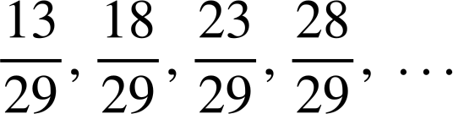
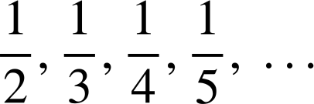
Identifying arithmetic sequences
1) Label these sequences as ‘arithmetic’ or ‘not arithmetic’.
a) 9, 13, 17, 21, 25, …
b) 37, 31, 25, 19, 13, …
c) −70, −68, −66, −64, −62, …
d) 35, 31, 26, 20, 13, …
e) 12.6, 13.7, 14.8, 15.9 …
f) 3, 6, 12, 24, 48, …
g)
h)

Slide 13
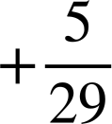

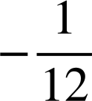
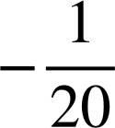
Identifying arithmetic sequences
1) Label these sequences as ‘arithmetic’ or ‘not arithmetic’.
a) 9, 13, 17, 21, 25, …
b) 37, 31, 25, 19, 13, …
+4
+4
+4
+4
Arithmetic
−6
−6
−6
−6
Arithmetic
c) −70, −68, −66, −64, −62, …
d) 35, 31, 26, 20, 13, …
+2
+2
+2
+2
Arithmetic
−4
−5
−6
−7
Not arithmetic
e) 12.6, 13.7, 14.8, 15.9 …
f) 3, 6, 12, 24, 48, …
+1.1
+1.1
+1.1
Arithmetic
Not arithmetic
+3
+6
+12
+24
g)
h)
Arithmetic
Not arithmetic

Slide 14
Checking understanding of arithmetic sequences
Identifying arithmetic sequences
Generating arithmetic sequences
Representations of arithmetic sequences

Slide 15
Generating arithmetic sequences
Arithmetic sequences can be expressed in terms of the relationship between the term number (n) and the term value (T).
Term number (n) | 1 | 2 | 3 | 4 | 5
Term value (T) | 3 | 6 | 9 | 12 | 15
In the case of the sequence 3, 6, 9, 12, 15, … when n = 1, T = 3
The term in the first position of the sequence has a value of 3

Slide 16
Generating arithmetic sequences
Arithmetic sequences can be expressed in terms of the relationship between the term number (n) and the term value (T).
Term number (n) | 1 | 2 | 3 | 4 | 5
Term value (T) | 3 | 6 | 9 | 12 | 15
When n = 5, T = 15
The term in the fifth position has a value of 15

Slide 17
Generating arithmetic sequences
In the case of the sequence 3, 6, 9, 12, 15, … there is an obvious relationship between the term number (n) and the term value (T).
Term number (n) | 1 | 2 | 3 | 4 | 5
Term (T) | 3 | 6 | 9 | 12 | 15
×3
The term value (T) is always three times the term number (n)
This is written more simply as an n^{th} term of 3n

Slide 18
Generating arithmetic sequences
In the case of the sequence 5, 10, 15, 20, 25, … there is an obvious relationship between the term number (n) and the term value (T).
Term number (n) | 1 | 2 | 3 | 4 | 5
Term (T) | 5 | 10 | 15 | 20 | 25
×5
The term value (T) is always five times the term number (n)
This is written more simply as an n^{th} term of 5n

Slide 19
Generating arithmetic sequences
The n^{th} term, in this case 5n, enables us to find any term in the sequence by substitution.
Term number (n) | 1 | 2 | 3 | 4 | 5 | 10 | 50 | 100
Term (T) | 5 | 10 | 15 | 20 | 25 | 50 | 250 | 500
×5
When n = 10, T = 5n = 5(10) = 50
When n = 50, T = 5(50) = 250
When n = 100, T = 5(100) = 500

Slide 20
Generating arithmetic sequences
Sometimes the relationship, the n^{th} term, might be two-step.
Term number (n) | 1 | 2 | 3 | 4 | 5
Term (T) | 5 | 9 | 13 | 17 | 21
×4 +1
The term value (T) is four times the term number (n) plus one.
When n = 1
T = 4n + 1 = 4(1) + 1 = 5
When n = 2
T = 4n + 1 = 4(2) + 1 = 9

Slide 21
Generating arithmetic sequences
Find the first five terms, and the 50th term of the sequence 2n + 5
Term number (n) | 1 | 2 | 3 | 4 | 5 | 50
Term (T) | 7 | 9 | 11 | 13 | 15 | 105
×2 +5
When n = 1
T = 2n + 5 = 2(1) + 5 = 7
When n = 2
T = 2n + 5 = 2(2) + 5 = 9

Slide 22
Checking understanding of arithmetic sequences
1) Find the first five terms of these four sequences:
a) 3n + 7
Term number (n) | 1 | 2 | 3 | 4 | 5
Term (T)
b) 3n − 7
Term number (n) | 1 | 2 | 3 | 4 | 5
Term (T)
c) 0.3n + 7
Term number (n) | 1 | 2 | 3 | 4 | 5
Term (T)
d) 7 − 3n
Term number (n) | 1 | 2 | 3 | 4 | 5
Term (T)

Slide 23
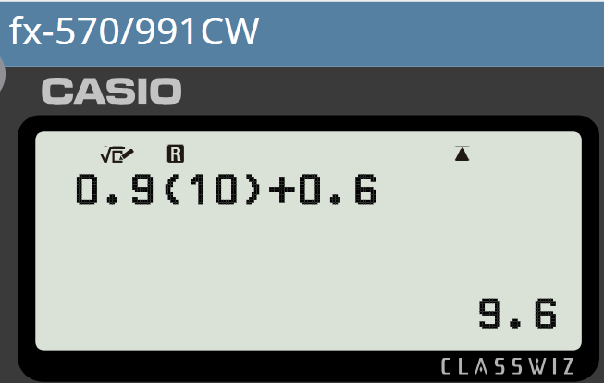
Checking understanding of arithmetic sequences
2) Find the 10th, 50th, and 100th terms of these sequences.
a) 9n + 6
You might choose to use your calculator for some.
b) 9n − 6
c) 0.9n + 0.6
d) 6 − 9n

Slide 24
Checking understanding of arithmetic sequences
1) Find the first five terms of these four sequences:
a) 3n + 7
Term number (n) | 1 | 2 | 3 | 4 | 5
Term (T)
Term number (n) | 1 | 2 | 3 | 4 | 5
Term (T) | 10 | 13 | 16 | 19 | 22
b) 3n − 7
Term number (n) | 1 | 2 | 3 | 4 | 5
Term (T)
Term number (n) | 1 | 2 | 3 | 4 | 5
Term (T) | −4 | −1 | 2 | 5 | 8
c) 0.3n + 7
Term number (n) | 1 | 2 | 3 | 4 | 5
Term (T)
Term number (n) | 1 | 2 | 3 | 4 | 5
Term (T) | 7.3 | 7.6 | 7.9 | 8.2 | 8.5
d) 7 − 3n
Term number (n) | 1 | 2 | 3 | 4 | 5
Term (T)
Term number (n) | 1 | 2 | 3 | 4 | 5
Term (T) | 4 | 1 | −2 | −5 | −8

Slide 25
Checking understanding of arithmetic sequences
2) Find the 10th, 50th, and 100th terms of these sequences.
a) 9n + 6
n = 10, T = 9n + 6 = 9(10) + 6 = 96
n = 50, T = 9n + 6 = 9(50) + 6 = 456
n = 100, T = 9n + 6 = 9(100) + 6 = 906
b) 9n − 6
n = 10, T = 9n − 6 = 9(10) − 6 = 84
n = 50, T = 9n − 6 = 9(50) − 6 = 444
n = 100, T = 9n − 6 = 9(100) − 6 = 894

Slide 26
Checking understanding of arithmetic sequences
2) Find the 10th, 50th, and 100th terms of these sequences.
c) 0.9n + 0.6
n = 10, T = 0.9n + 0.6 = 0.9(10) + 0.6 = 9.6
n = 50, T = 0.9n + 0.6 = 0.9(50) + 0.6 = 45.6
n = 100, T = 0.9n + 0.6 = 0.9(100) + 0.6 = 90.6
d) 6 − 9n
n = 10, T = 6 − 9n = 6 − 9(10) = −84
n = 50, T = 6 − 9n = 6 − 9(50) = −444
n = 100, T = 6 − 9n = 6 − 9(100) = −894

Slide 27
Checking understanding of arithmetic sequences
Identifying arithmetic sequences
Generating arithmetic sequences
Representations of arithmetic sequences

Slide 28
Representations of arithmetic sequences
How is this pattern growing?...
,
,
,
, …
Constantly adding three counters each time.
The next pattern would be the fourth pattern…
…plus another three.

Slide 29
Representations of arithmetic sequences
This is an example of a visual representation of an arithmetic sequence.
,
,
,
,
, …
2,
5,
8,
11,
14,
+3
+3
+3
+3

Slide 30
Representations of arithmetic sequences
Arranging the same sequence this way shows us something about the underlying structure of arithmetic sequences.
You can see the constant, additive difference more easily…
And you can see why they are also known as linear sequences.

Slide 31
Representations of arithmetic sequences
We could see this same linear structure if we plotted the sequence graphically.
Term number (n) | 1 | 2 | 3 | 4 | 5
Term (T) | 2 | 5 | 8 | 11 | 14
We can plot these by labelling our axes ‘Term value (T)’ and ‘Term number (n)’.

Slide 32
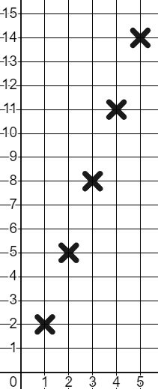
Representations of arithmetic sequences
We could see this same linear structure if we plotted the sequence graphically.
Term value (T)
Term number (n) | 1 | 2 | 3 | 4 | 5
Term (T) | 2 | 5 | 8 | 11 | 14
We can plot these by labelling our axes ‘Term value (T)’ and ‘Term number (n)’.
Term number (n)

Slide 33
Representations of arithmetic sequences
We could see this same linear structure if we plotted the sequence graphically.
Term value (T)
Term number (n) | 1 | 2 | 3 | 4 | 5
Term (T) | 2 | 5 | 8 | 11 | 14
Whilst we can see that the points align…
We only plot the coordinates, we don’t draw the straight line here, though it’s a nice way to check for a linear sequence.
Term number (n)

Slide 34
Representations of arithmetic sequences
This sequence will plot points in a straight line.
Term number (n) | 1 | 2 | 3 | 4 | 5
Term (T) | 10 | 16 | 22 | 28 | 34
10, 16, 22, 28, 34, … is an arithmetic sequence therefore linear; the points will align.
The points could be anywhere. Not necessarily in a straight line.

Slide 35
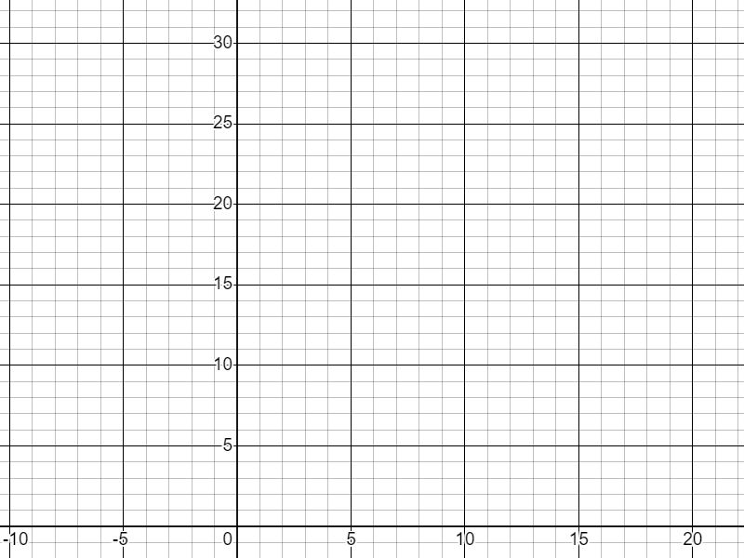


Representations of arithmetic sequences
Andeep and Laura are trying to plot the arithmetic sequence starting:
34, 28, 22, 16, 10, …
Term value (T)
This sequence will have negative terms so it can’t be plotted.
Do you agree with Andeep?
Term number (n)

Slide 36
Representations of arithmetic sequences
Andeep and Laura are trying to plot the arithmetic sequence starting:
34, 28, 22, 16, 10, …
Term value (T)
34, 28, 22, 16, 10, 4, −2, −8, −14, …
This sequence will have negative terms so it can’t be plotted.
You are right, there will be negative terms. But, we can plot those in the 4th quadrant.
You are right, there will be negative terms.
Term number (n)

Slide 37
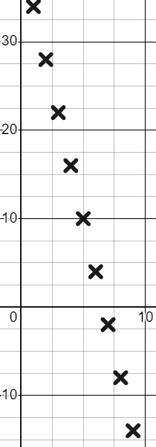
Representations of arithmetic sequences
Andeep and Laura are trying to plot the arithmetic sequence starting:
34, 28, 22, 16, 10, 4, −2, −8, −14, …
Term value (T)
It can be plotted! We just use the 4th quadrant. Thanks Laura!
Term number (n)
You are right, there will be negative terms. But, we can plot those in the 4th quadrant.

Slide 38
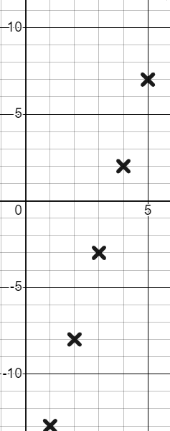
Representations of arithmetic sequences
T
The negative terms of the sequence −13,−8,−3, 2, 7 … can not be plotted.
n
The values of an arithmetic sequence have to be positive in order to plot it.
They can be plotted using the 4th quadrant.

Slide 39
Representations of arithmetic sequences
1) Draw a visual representation for the first five terms of these sequences:
a) 5, 7, 9, 11,13, …
b) 21,17,13, 9, 5
c) 5n + 1

Slide 40
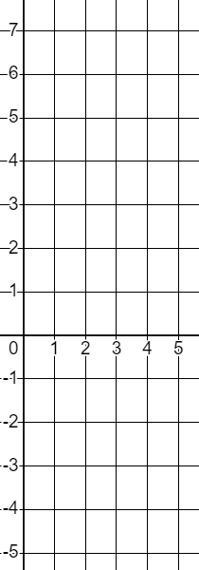
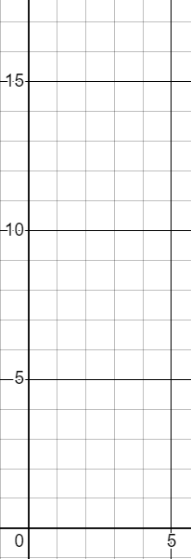
Representations of arithmetic sequences
2) Plot the first five terms of these sequences:
T
a) 4n − 3
T
b) 10 − 3n
n | 1 | 2 | 3 | 4 | 5
T
n | 1 | 2 | 3 | 4 | 5
T
n
n

Slide 41


Representations of arithmetic sequences
1) Draw a visual representation for the first five terms of these sequences:
a) 5, 7, 9, 11,13, …
b) 13,10, 7, 4, 1
c) 5n + 1
Examples of what they might look like:
n | 1 | 2 | 3 | 4 | 5
T | 6 | 11 | 16 | 21 | 26
In each case the linear structure of the sequence is revealed.

Slide 42
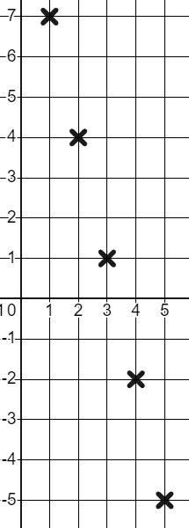
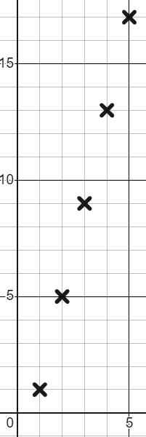
Representations of arithmetic sequences
2) Plot the first five terms of these sequences:
T
a) 4n − 3
b) 10 − 3n
T
n | 1 | 2 | 3 | 4 | 5
T | 1 | 5 | 9 | 13 | 17
n | 1 | 2 | 3 | 4 | 5
T
n | 1 | 2 | 3 | 4 | 5
T
n | 1 | 2 | 3 | 4 | 5
T | 7 | 4 | 1 | −2 | −5
n
n

Slide 43
Checking understanding of arithmetic sequences
Any term in an arithmetic sequence can be expressed in terms of its position in the sequence and we can generate any term using the n^{th} term.
For example, in the sequence 7n − 5 the 1st term is
7(1) − 5 = 2 where as the 10th term is 7(10) − 5 = 65

Slide 44

© Oak National Academy 2024.
Produced in partnership with Mathematics in Education and Industry.
Licensed on the Open Government Licence v3.0, except where otherwise stated. See Oak terms and conditions.

